Slide 1
EVENT HANDLING

Slide 2
Event handling is at the core of successful GUI programming
There are several types of events
The most commonly handled events are those generated by the mouse, the keyboard, and various controls, such as a push button
Events are supported by the java.awt.event package

Slide 3
The Delegation Event Model
Defines standard and consistent mechanisms to generate and process events
A source generates an event and sends it to one or more listeners
The listener simply waits until it receives an event
Once received, the listener processes the event and then returns

Slide 4
The advantage of this design is that the application logic that processes events is cleanly separated from the user interface logic that generates those events
In the delegation event model, listeners must register with a source in order to receive an event notification
03/25/18

Slide 5
Event Handling Model of AWT
Event object
Event handling
methods
Event source
Event listener

Slide 6
Action Events on Buttons
ActionEvent
actionPerformed(..)
Button
ActionListener

Slide 7
Events
In the delegation model, an event is an object that describes a state change in a source
It can be generated as a consequence of a person interacting with the elements in a graphical user interface
Some of the activities that cause events to be generated are pressing a button, entering a character via the keyboard, selecting an item in a list, and clicking the mouse

Slide 8
Events may also occur that are not directly caused by interactions with a user interface.
For example, an event may be generated when a timer expires, a counter exceeds a value, a software or hardware failure occurs, or an operation is completed.

Slide 9
Event Sources
A source is an object that generates an event
Sources may generate more than one type of event
A source must register listeners in order for the listeners to receive notifications about a specific type of event
Each type of event has its own registration method.
The general form:
public void addTypeListener(TypeListener el)
Type is the name of the event and el is a reference to the event listener

Slide 10
A source must also provide a method that allows a listener to unregister an interest in a specific type of event
The general form of such a method is this:
public void removeTypeListener(TypeListener el)
Here, Type is the name of the event and el is a reference to the event listener
The method that registers a keyboard event listener is called addKeyListener(). The method that registers a mouse motion listener is called addMouseMotionListener( ).
multicasting the event - all registered listeners are notified

Slide 11
Event Listeners
A listener is an object that is notified when an event occurs
It has two major requirements
First, it must have been registered with one or more sources to receive notifications about specific types of events
Second, it must implement methods to receive and process these notifications
The methods that receive and process events are defined in a set of interfaces found in java.awt. event. For example, the mouseMotionListener interface defines two methods to receive notifications when the mouse is dragged or moved.

Slide 12
Event Classes
Java defines several types of events defined by AWT and Swing classes
At the root of the Java event class hierarchy is EventObject, which is in java.util
It is the superclass for all events. Its one constructor is shown here:
EventObject(Object src)
Here, src is the object that generates this event

Slide 13
EventObject contains two methods: getSource( ) and toString( )
The getSource( ) method returns the source of the event Object getSource( )
toString( ) returns the string equivalent of the event

Slide 14
The class AWTEvent, defined within the java.awt package, is a subclass of EventObject
It is the superclass (either directly or indirectly) of all AWT-based events used by the delegation event model
Its getID( ) method can be used to determine the type of the event int getID( )

Slide 15
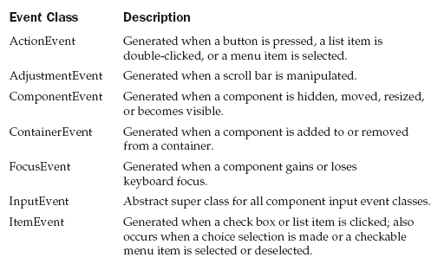
Main Event Classes in java.awt.event

Slide 16
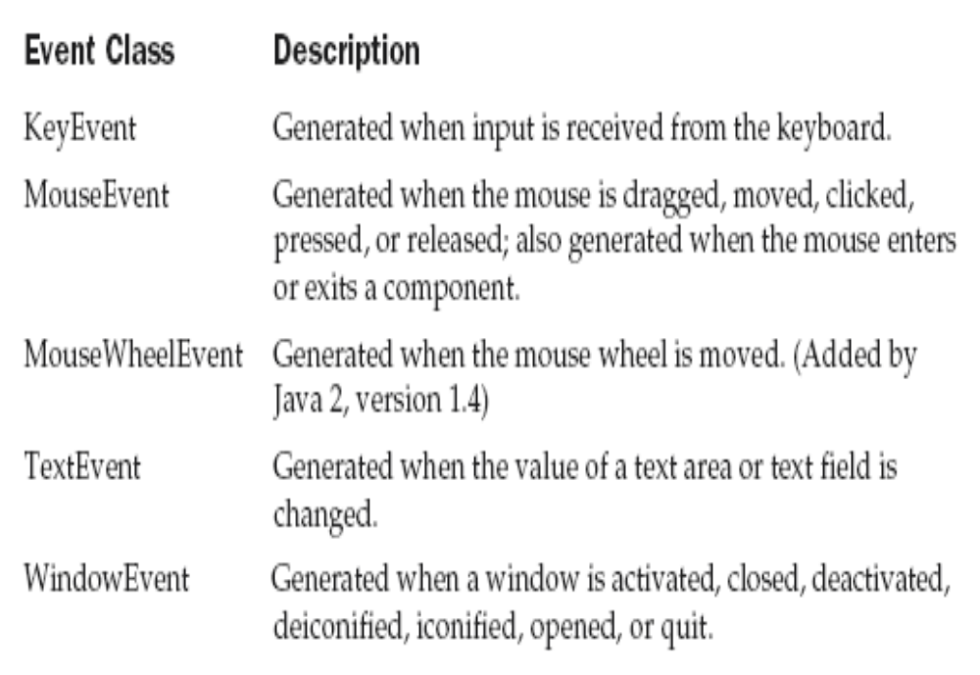

Slide 17
The ActionEvent Class
An ActionEvent is generated when a button is pressed, a list item is double-clicked, or a menu item is selected
The ActionEvent class defines four integer constants that can be used to identify any modifiers associated with an action event: ALT_MASK, CTRL_MASK, META_MASK, and SHIFT_MASK
In addition, there is an integer constant, ACTION_PERFORMED, which can be used to identify action events

Slide 18
ActionEvent has these three constructors:
ActionEvent(Object src, int type, String cmd)
ActionEvent(Object src, int type, String cmd, int modifiers)
ActionEvent(Object src, int type, String cmd, long when, int modifiers)

Slide 19
Here, src is a reference to the object that generated this event
The type of the event is specified by type, and its command string is cmd
The argument modifiers indicates which modifier keys (ALT, CTRL, META, and/or SHIFT) were pressed when the event was generated
The when parameter specifies when the event occurred

Slide 20
You can obtain the command name for the invoking ActionEvent object by using the getActionCommand( ) method, shown here:
String getActionCommand( )
For example, when a button is pressed, an action event is generated that has a command name equal to the label on that button
The getModifiers( ) method returns a value that indicates which modifier keys (ALT, CTRL, META, and/or SHIFT) were pressed when the event was generated. Its form is shown here:
int getModifiers( )

Slide 21
The method getWhen( ) returns the time at which the event took place. This is called the event’s timestamp.
long getWhen( )

Slide 22
The AdjustmentEvent Class
An AdjustmentEvent is generated by a scroll bar
The AdjustmentEvent class defines integer constants that can be used to identify them

Slide 23
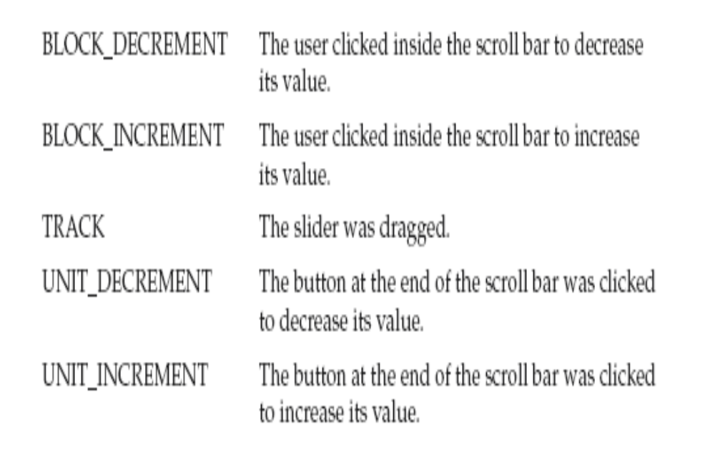

Slide 24
In addition, there is an integer constant, ADJUSTMENT_VALUE_CHANGED, that indicates that a change has occurred
The constructor:
AdjustmentEvent(Adjustable src, int id, int type, int data)
src is a reference to the object that generated this event
The id equals ADJUSTMENT_VALUE_CHANGED
The type of the event is specified by type, and its associated value is data

Slide 25
The getAdjustable( ) method returns the object that generated the event
  Adjustable getAdjustable( )
The type of the adjustment event may be obtained by the getAdjustmentType( ) method. It returns one of the constants defined by AdjustmentEvent
int getAdjustmentType( )
The amount of the adjustment can be obtained from the getValue( ) method, shown here: int getValue( )

Slide 26
The ComponentEvent Class
A ComponentEvent is generated when the size, position, or visibility of a component is changed
There are four types of component events
The ComponentEvent class defines integer constants that can be used to identify them

Slide 27
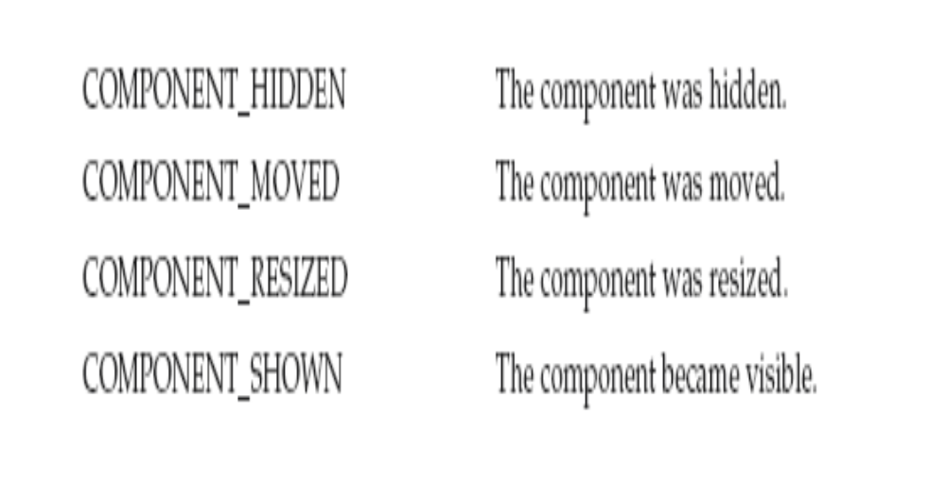

Slide 28
Constructor:
ComponentEvent(Component src, int type)
src is a reference to the object that generated this event
The type of the event is specified by type
ComponentEvent is the superclass either directly or indirectly of ContainerEvent, FocusEvent, KeyEvent, MouseEvent, and WindowEvent
The getComponent( ) method returns the component that generated the event

Slide 29
The ContainerEvent Class
A ContainerEvent is generated when a component is added to or removed from a container
The ContainerEvent class defines int constants that can be used to identify them: COMPONENT_ADDED and COMPONENT_REMOVED
03/25/18

Slide 30
ContainerEvent is a subclass of
ComponentEvent and has this constructor:
ContainerEvent(Component src, int type, Component comp)
src is a reference to the container that generated this event
The type of the event is specified by type and the component that has been added to or removed from the container is comp
You can obtain a reference to the container that generated this event by using the getContainer( ) method

Slide 31
The FocusEvent Class
A FocusEvent is generated when a component gains or loses input focus
These events are identified by the integer constants FOCUS_GAINED and FOCUS_LOST
FocusEvent is a subclass of ComponentEvent and has these constructors:
FocusEvent(Component src, int type)
FocusEvent(Component src, int type, boolean temporaryFlag)
Focus Event(Component src, int type, boolean temporaryFlag, Component other)

Slide 32
src is a reference to the component that generated this event
The type of the event is specified by type
The argument temporaryFlag is set to true if the focus event is temporary; Otherwise, it is set to false
If a FOCUS_GAINED event occurred, other will refer to the component that lost focus
Conversely, if a FOCUS_LOST event occurred, other will refer to the component that gains focus

Slide 33
The InputEvent Class
The abstract class InputEvent is a subclass of ComponentEvent and is the superclass for component input events
Its subclasses are KeyEvent and MouseEvent
To test if a modifier was pressed at the time of event generated use the following:
boolean isAltDown( )
boolean isAltGraphDown( )
boolean isControlDown( )
boolean isMetaDown( )
boolean isShiftDown( )

Slide 34
InputEvent defines several integer constants that represent any modifiers.Originally, the InputEvent class defined the following eight values to represent the modifiers. Because of possible conflicts between the modifiers used by keyboard events and mouse events, and other issues, Java 2, version 1.4 added the following extended modifier values.
ALT_MASK BUTTON2_MASK META_MASK
ALT_GRAPH_MASK BUTTON3_MASK SHIFT_MASK
BUTTON1_MASK CTRL_MASK
ALT_DOWN_MASK
ALT_GRAPH_DOWN_MASK
BUTTON1_DOWN_MASK
BUTTON2_DOWN_MASK
BUTTON3_DOWN_MASK
CTRL_DOWN_MASK
META_DOWN_MASK
SHIFT_DOWN_MASK

Slide 35
The ItemEvent Class
An ItemEvent is generated when a check box or a list item is clicked or when a checkable menu item is selected or deselected
There are two types of item events, which are identified by the following integer constants:
DESELECTED The user deselected an item.
SELECTED The user selected an item.
ItemEvent has this constructor:
ItemEvent(ItemSelectable src, int type, Object entry, int state)
src is a reference to the component that generated this event

Slide 36
The type of the event is specified by type
The specific item that generated the item event is passed in entry
The current state of that item is in state
The getItem( ) method can be used to obtain a reference to the item that generated an event. Its signature : Object getItem( )
The getItemSelectable( ) method can be used to obtain a reference to the ItemSelectable object that generated an event. Its general form : ItemSelectable getItemSelectable( ) (list and choices)
The getStateChange( ) method returns the state change (i.e., SELECTED or DESELECTED) for the event. int getStateChange( )
03/25/18

Slide 37
The KeyEvent Class
A KeyEvent is generated when keyboard input occurs
There are three types of key events, which are identified by these integer constants: KEY_PRESSED, KEY_RELEASED, and KEY_TYPED
The first two events are generated when any key is pressed or released
The last event occurs only when a character is generated
For example, pressing the SHIFT key does not generate a character

Slide 38
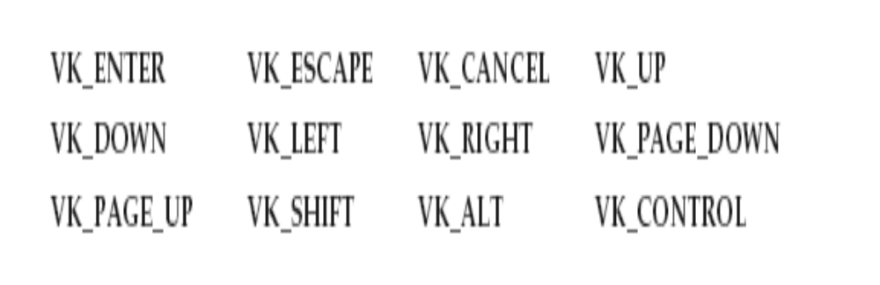
There are many other integer constants that are defined by KeyEvent
VK_0 through VK_9 and VK_A through VK_Z define the ASCII equivalents of the numbers and letters

Slide 39
KeyEvent is a subclass of InputEvent. Here are two of its constructors:
KeyEvent(Component src, int type, long when, int modifiers, int code)
KeyEvent(Component src, int type, long when, int modifiers, int code, char ch)
src is a reference to the component that generated the event
The type of the event is specified by type
The system time at which the key was pressed is passed in when
The modifiers argument indicates which modifiers were pressed when this key event occurred
The virtual key code, such as VK_UP, VK_A, and so forth, is passed in code
03/25/18

Slide 40
The character equivalent (if one exists) is passed in ch
If no valid character exists, then ch contains CHAR_UNDEFINED
For KEY_TYPED events, code will contain VK_UNDEFINED
The KeyEvent class defines several methods, but the most commonly used ones are getKeyChar( ), which returns the character that was entered, and getKeyCode( ), which returns the key code. Their general forms : char getKeyChar( )
int getKeyCode( )

Slide 41
The MouseEvent Class
There are eight types of mouse events
MouseEvent is a subclass of InputEvent.
The MouseEvent class defines the following integer constants that can be used to identify them:

Slide 42
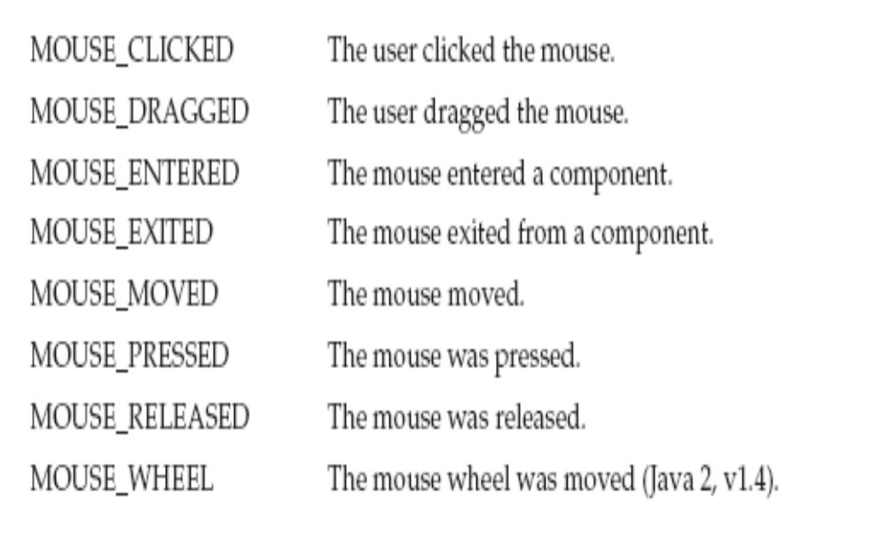
03/25/18

Slide 43
MouseEvent(Component src, int type, long when, int modifiers, int x, int y, int clicks, boolean triggersPopup)
The modifiers argument indicates which modifiers were pressed when a mouse event occurred
The coordinates of the mouse are passed in x and y. The click count is passed in clicks
The triggersPopup flag indicates if this event causes a pop-up menu to appear on this platform

Slide 44
The TextEvent Class
Instances of this class describe text events
These are generated by text fields and text areas when characters are entered by a user or program
TextEvent defines the integer constant TEXT_VALUE_CHANGED
The one constructor for this class is shown here:
TextEvent(Object src, int type)
src is a reference to the object that generated this event, type of the event is specified by type

Slide 45
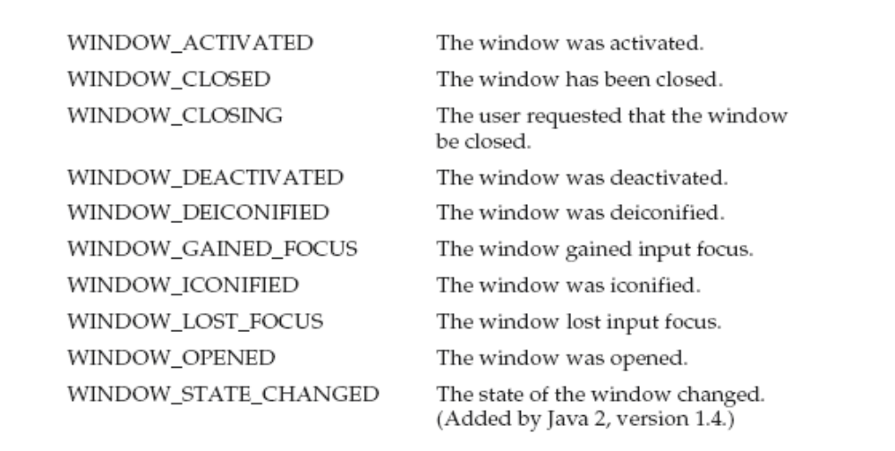
The WindowEvent Class
The WindowEvent class defines integer constants that can be used to identify them

Slide 46
WindowEvent is a subclass of ComponentEvent. It defines several constructors.The first one is
WindowEvent(Window src, int type)
src is a reference to the object that generated this event
The type of the event is type

Slide 47
WindowEvent(Window src, int type, Window other)
WindowEvent(Window src, int type, int fromState, int toState)
WindowEvent(Window src, int type, Window other, int fromState, int toState)

Slide 48
other specifies the opposite window when a focus event occurs
The fromState specifies the prior state of the window and toState specifies the new state that the window will have when a window state change occurs

Slide 49
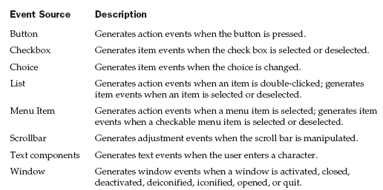
Sources of Events

Slide 50
Event Listener Interfaces
Listeners are created by implementing one or more of the interfaces defined by the java.awt.event package
When an event occurs, the event source invokes the appropriate method defined by the listener and provides an event object as its argument

Slide 51
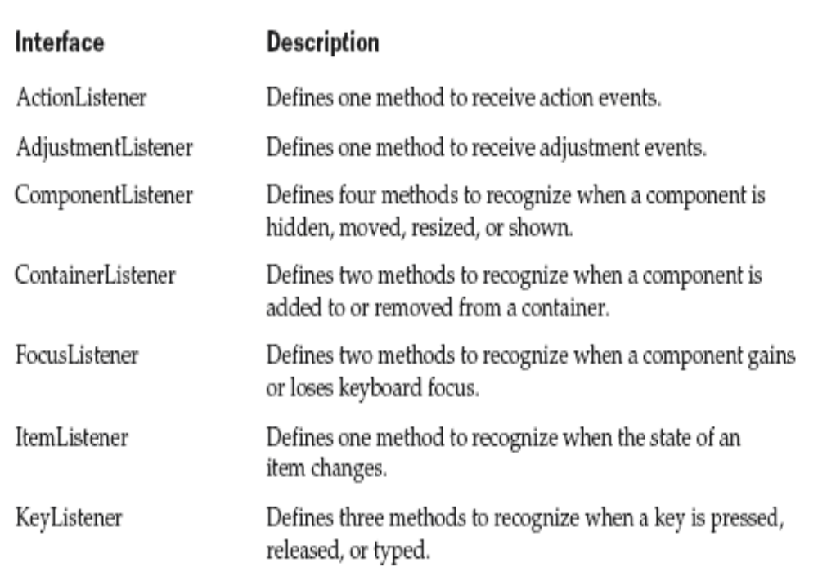

Slide 52
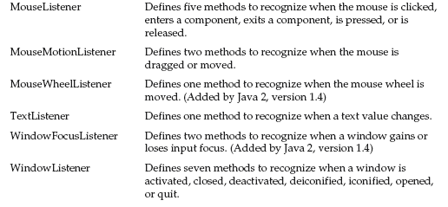

Slide 53
The ActionListener Interface
This interface defines the actionPerformed( ) method that is invoked when an action event occurs. Its general form is shown here:
void actionPerformed(ActionEvent ae)

Slide 54
// Demonstrate Buttons
import java.awt.*;
import java.awt.event.*;
import java.applet.*;
/*
<applet code="ButtonDemo" width=250 height=150>
</applet>
*/
public class ButtonDemo extends Applet implements ActionListener {
String msg = "";
Button yes, no, maybe;
public void init() {
yes = new Button("Yes");
no = new Button("No");
maybe = new Button("Undecided");

Slide 55
add(yes);
add(no);
add(maybe);
yes.addActionListener(this);
no.addActionListener(this);
maybe.addActionListener(this);
}
public void actionPerformed(ActionEvent ae) {
String str = ae.getActionCommand();
if(str.equals("Yes")) {
msg = "You pressed Yes.";
}
else if(str.equals("No")) {
msg = "You pressed No.";
}

Slide 56
else {
msg = "You pressed Undecided.";
}
repaint();
}
public void paint(Graphics g) {
g.drawString(msg, 6, 100);
}
}

Slide 57
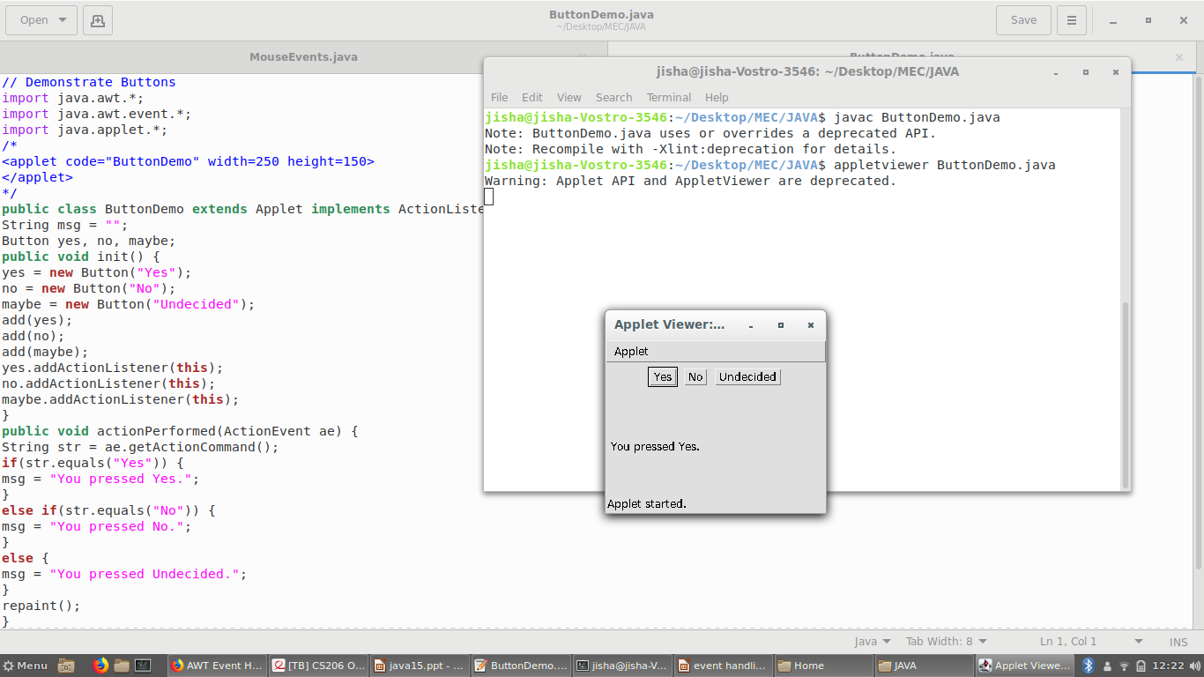

Slide 58
Example
Hello World (version 1)
import java.awt.*;
import java.awt.event.*;
public class TestButtonAction {
public static void main(String[] args){
Frame f = new Frame("TestButton");
f.setSize(200,200);
Button hw = new Button("Hello World!");
f.add(hw);
hw.addActionListener(new ActionListener(){
public void actionPerformed(ActionEvent e){
System.exit(0);
}
});
f.setVisible(true);
}
}

Slide 59
Hello World (version 2)
import java.awt.*;
import java.awt.event.*;
class MyFrame extends Frame implements ActionListener {
Button hw;
public MyFrame(){
super("Test Button");
setSize(200,200);
hw = new Button("Hello World!");
add(hw);
hw.addActionListener(this);
setVisible(true);
}
public void actionPerformed(ActionEvent o){
System.exit(0);
}
public static void main(String[] args){
MyFrame f = new MyFrame();
}
}

Slide 60
Hello World (version 3)
import java.awt.*;
import java.awt.event.*;
class MyFrame extends Frame {
Button hw;
public MyFrame(){
super("Test Button");
class MyActionListener implements ActionListener {
public void actionPerformed(ActionEvent o){
System.exit(0);
} }
setSize(200,200);
hw = new Button("Hello World!");
add(hw);
hw.addActionListener(new MyActionListener());
setVisible(true);
}
public static void main(String[] args){
MyFrame f = new MyFrame();
}
}

Slide 61
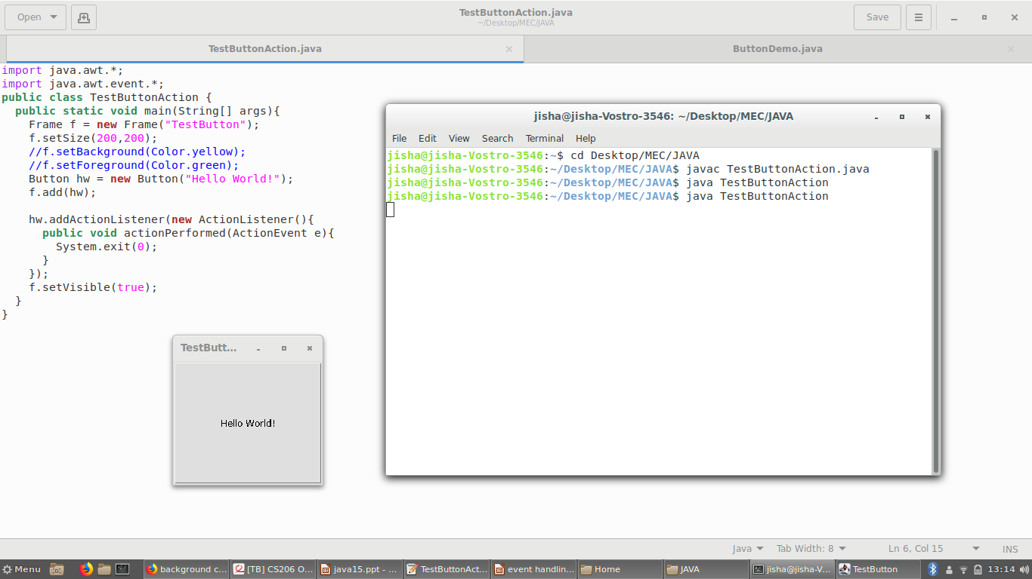

Slide 62
The AdjustmentListener Interface
This interface defines the adjustmentValueChanged( ) method that is invoked when an adjustment event occurs. Its general form is shown here:
void adjustmentValueChanged(AdjustmentEvent ae)

Slide 63
To process scroll bar events, you need to implement the AdjustmentListener interface.
Each time a user interacts with a scroll bar, an AdjustmentEvent object is generated.
Its getAdjustmentType( ) method can be used to determine the type of the adjustment.
The use of setPreferredSize( ) to set the size of the scrollbars.

Slide 64
// Demonstrate scroll bars.
import java.awt.*;
import java.awt.event.*;
import java.applet.*;
/*
<applet code="SBDemo" width=300 height=200>
</applet>
*/
public class SBDemo extends Applet
implements AdjustmentListener {
String msg = "";
Scrollbar vertSB, horzSB;
public void init() {
vertSB = new Scrollbar(Scrollbar.VERTICAL,0, 1, 0, 300);
vertSB.setPreferredSize(new Dimension(20, 100));

Slide 65
horzSB = new Scrollbar(Scrollbar.HORIZONTAL,0, 1, 0, 500);
horzSB.setPreferredSize(new Dimension(100, 20));
add(vertSB);
add(horzSB);
// register to receive adjustment events
vertSB.addAdjustmentListener(this);
horzSB.addAdjustmentListener(this);
}
public void adjustmentValueChanged(AdjustmentEvent ae) {
msg="value:"+ae.getValue();
repaint();
}
public void paint(Graphics g) {
g.drawString(msg, 6, 160);
}
}

Slide 66
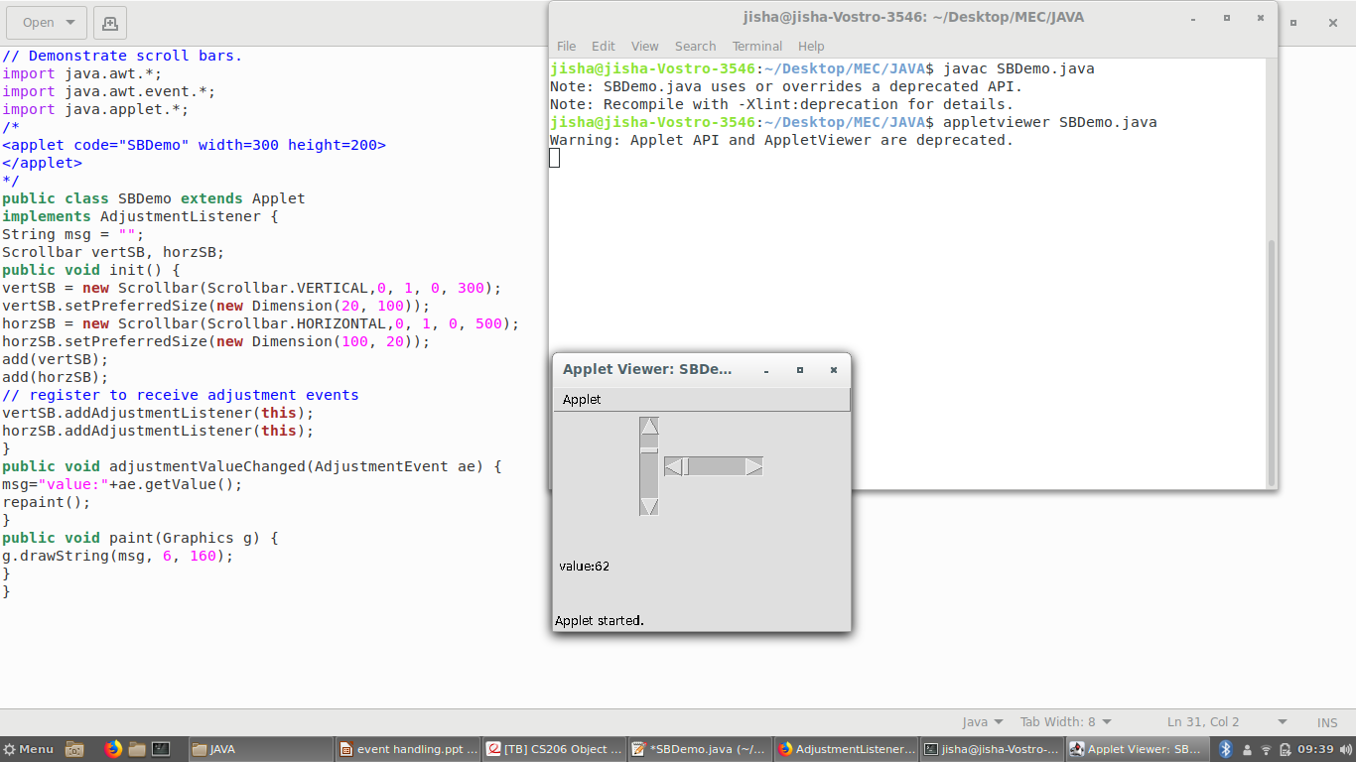

Slide 67
The ComponentListener Interface
This interface defines four methods that are invoked when a component is resized, moved,
shown, or hidden.
void componentResized(ComponentEvent ce)
void componentMoved(ComponentEvent ce)
void componentShown(ComponentEvent ce)
void componentHidden(ComponentEvent ce)

Slide 68
The ContainerListener Interface
This interface contains two methods.
When a component is added to a container,
componentAdded( ) is invoked.
When a component is removed from a container, componentRemoved( ) is invoked.
void componentAdded(ContainerEvent ce)
void componentRemoved(ContainerEvent ce)

Slide 69
The FocusListener Interface
This interface defines two methods
When a component obtains keyboard focus, focusGained( ) is invoked
When a component loses keyboard focus, focusLost( ) is called
Their general forms are shown here:
void focusGained(FocusEvent fe)
void focusLost(FocusEvent fe)
03/25/18

Slide 70
The KeyListener Interface
This interface defines three methods
The keyPressed( ) and keyReleased( ) methods are invoked when a key is pressed and released, respectively
The keyTyped( ) method is invoked when a character has been entered
03/25/18

Slide 71
if a user presses and releases the A key, three events are generated in sequence: key pressed, typed, and released
If a user presses and releases the HOME key, two key events are generated in sequence: key pressed and released
The general forms of these methods are shown here:
void keyPressed(KeyEvent ke)
void keyReleased(KeyEvent ke)
void keyTyped(KeyEvent ke)
03/25/18

Slide 72
The MouseListener Interface
This interface defines five methods
void mouseClicked(MouseEvent me)
void mouseEntered(MouseEvent me)
void mouseExited(MouseEvent me)
void mousePressed(MouseEvent me)
void mouseReleased(MouseEvent me)
03/25/18

Slide 73
The MouseMotionListener Interface
void mouseDragged(MouseEvent me)
void mouseMoved(MouseEvent me)
03/25/18

Slide 74
The MouseWheelListener Interface
This interface defines the mouseWheelMoved( ) method that is invoked when the mouse wheel is moved.
void mouseWheelMoved(MouseWheelEvent mwe)
03/25/18

Slide 75
The TextListener Interface
Defines the textChanged( ) method that is invoked when a change occurs in a text area or text field
void textChanged(TextEvent te)
03/25/18

Slide 76
The WindowFocusListener Interface
defines two methods:
windowGainedFocus( ) and windowLostFocus( )
These are called when a window gains or looses input focus
void windowGainedFocus(WindowEvent we)
void windowLostFocus(WindowEvent we)
03/25/18

Slide 77
The WindowListener Interface
void windowActivated(WindowEvent we)
void windowClosed(WindowEvent we)
void windowClosing(WindowEvent we)
void windowDeactivated(WindowEvent we)
void windowDeiconified(WindowEvent we)
void windowIconified(WindowEvent we)
void windowOpened(WindowEvent we)
03/25/18

Slide 78
Handling Mouse Events ExMouse.java
// Demonstrate the mouse event handlers.
import java.awt.*;
import java.awt.event.*;
import java.applet.*;
/*
<applet code="MouseEvents" width=300 height=100>
</applet>
*/
03/25/18

Slide 79
public class MouseEvents extends Applet
implements MouseListener, MouseMotionListener {
String msg = "";
int mouseX = 0, mouseY = 0; // coordinates of mouse
public void init() {
addMouseListener(this); //registering
addMouseMotionListener(this);
}
public void mouseClicked(MouseEvent me) {
// save coordinates
mouseX = 0;
mouseY = 10;
msg = "Mouse clicked.";
repaint();
}
03/25/18

Slide 80
// Handle mouse entered.
public void mouseEntered(MouseEvent me) {
// save coordinates
mouseX = 0;
mouseY = 10;
msg = "Mouse entered.";
repaint();
}
public void mouseExited(MouseEvent me) {
// save coordinates
mouseX = 0;
mouseY = 10;
msg = "Mouse exited.";
repaint();
}
03/25/18

Slide 81
public void mousePressed(MouseEvent me) {
// save coordinates
mouseX = me.getX();
mouseY = me.getY();
msg = "Down";
repaint();
}
public void mouseReleased(MouseEvent me) {
// save coordinates
mouseX = me.getX();
mouseY = me.getY();
msg = "Up";
repaint();
}
public void mouseDragged(MouseEvent me) {
03/25/18

Slide 82
// save coordinates
mouseX = me.getX();
mouseY = me.getY();
msg = "*";
showStatus("Dragging mouse at " + mouseX + ", " + mouseY);
repaint();
}
// Handle mouse moved.
public void mouseMoved(MouseEvent me) {
// show status-applet method
showStatus("Moving mouse at " + me.getX() + ", " + me.getY());
}
// Display msg in applet window at current X,Y location.
03/25/18

Slide 83
public void paint(Graphics g) {
g.drawString(msg, mouseX, mouseY);
}
}
03/25/18

Slide 84
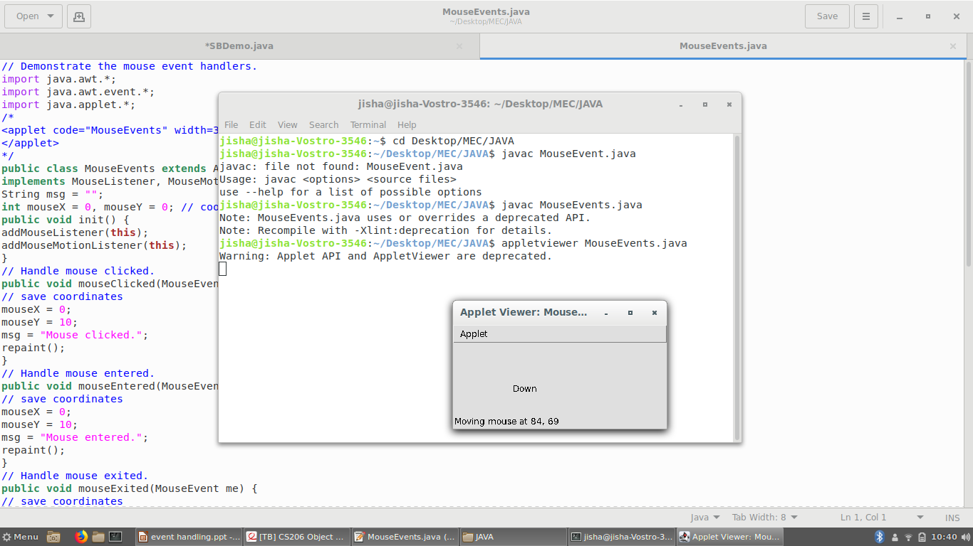

Slide 85
Handling Keyboard Events simplekey.java
import java.awt.*;
import java.awt.event.*;
import java.applet.*;
/* <applet code="SimpleKey" width=300 height=100>
</applet> */
public class SimpleKey extends Applet
implements KeyListener {
String msg = "";
int X = 10, Y = 20; // output coordinates
public void init() {
addKeyListener(this);
requestFocus(); // request input focus
}
03/25/18

Slide 86
public void keyPressed(KeyEvent ke) {
showStatus("Key Down");
}
public void keyReleased(KeyEvent ke) {
showStatus("Key Up");
}
public void keyTyped(KeyEvent ke) {
msg += ke.getKeyChar();
repaint();
} // Display keystrokes.
public void paint(Graphics g) {
g.drawString(msg, X, Y);
} }
03/25/18

Slide 87
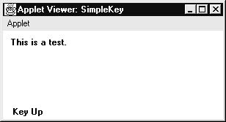
If you want to handle the special keys, such as the arrow or function keys, you need to respond to them within the keyPressed( ) handler.
They are not available through keyTyped( ). To identify the keys, you use their virtual key codes.
03/25/18

Slide 88
// Demonstrate some virtual key codes. //Keyevents.java
import java.awt.*;
import java.awt.event.*;
import java.applet.*;
/*
<applet code="KeyEvents" width=300 height=100>
</applet>
*/
public class KeyEvents extends Applet
implements KeyListener {
String msg = "";
int X = 10, Y = 20; // output coordinates
public void init() {
03/25/18

Slide 89
addKeyListener(this);
requestFocus(); // request input focus
}
public void keyPressed(KeyEvent ke) {
showStatus("Key Down");
int key = ke.getKeyCode();
switch(key) {
case KeyEvent.VK_F1:
msg += "<F1>";
break;
case KeyEvent.VK_F2:
msg += "<F2>";
break;
case KeyEvent.VK_F3:
msg += "<F3>"; break;
03/25/18

Slide 90
case KeyEvent.VK_PAGE_DOWN:
msg += "<PgDn>";
break;
case KeyEvent.VK_PAGE_UP:
msg += "<PgUp>";
break;
case KeyEvent.VK_LEFT:
msg += "<Left Arrow>";
break;
case KeyEvent.VK_RIGHT:
msg += "<Right Arrow>";
break;
}
03/25/18

Slide 91
repaint();
}
public void keyReleased(KeyEvent ke) {
showStatus("Key Up");
}
public void keyTyped(KeyEvent ke) {
msg += ke.getKeyChar();
repaint();
}
// Display keystrokes.
public void paint(Graphics g) {
g.drawString(msg, X, Y);
}
}
03/25/18

Slide 92
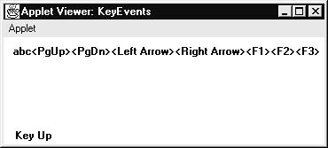
The procedures shown in the preceding keyboard and mouse event examples can be generalized to any type of event handling, including those events generated by controls.
03/25/18

